Slide 1

CHRONOFLEX ADAPTIVE FPGA TIMEKEEPER
https://github.com/vardhan3003/ChronoFlex-Adaptive-FPGA-Timekeeper

Slide 2


The Reason Behind My Interest:

Slide 3

Precision in Every Tick: The Inspiration Behind ChronoFlex-Adaptive-FPGA-Timekeeper
The inspiration behind ChronoFlex-Adaptive-FPGA-Timekeeper comes from my fascination with the precision and concurrency of digital clocks. Their ability to maintain nanosecond accuracy while handling multiple functionalities intrigued me, especially with just four seven-segment displays. My experience in programming deepened my interest in parallelism, driving me to design this FPGA-based timekeeping system in Verilog, ensuring precise synchronization across all operations.

Slide 4


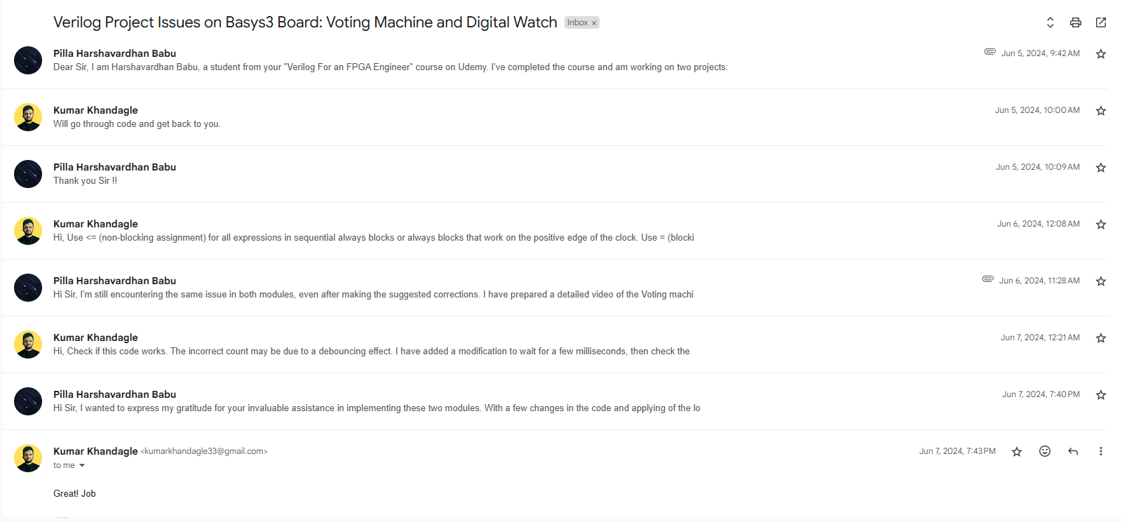
Initial Guidance

Slide 5
Key Functionalities of ChronoFlex-Adaptive-FPGA-Timekeeper
Multiple Modes:
Clock Mode: Displays real-time clock.
Edit Mode: Allows modification of date, month, and time.
Timer Mode: Runs up to a maximum of 59 minutes and 59 seconds.
Stopwatch Mode: Operates up to 59 minutes and 59 seconds.
Alarm Mode: Configurable to set alarms.
Push Button Controls:
Mode Button: Switches between different modes.
Reset Button: Resets:
Time values in Edit Mode to 00:00.
Timer and Stopwatch to 00:00.
Date and Month to 1st Jan (default).
Increment Button: Increases values of time, date, timer, stopwatch, and alarm settings.
Long Press: Displays the current date and time.
Edit Shift Button: Shifts between hour and minute settings in Edit Mode, Alarm Mode, and Stopwatch/Timer settings.

Slide 6
Key Functionalities of ChronoFlex-Adaptive-FPGA-Timekeeper
Start/Stop Button:
Controls start/stop functionality in Stopwatch, Timer, and Alarm modes.
Stops the alarm buzzer when ringing.
Long Press: Displays the alarm time if the alarm is set.
LED Indicators:
Show the current mode of operation.
Indicate buzzer on/off status during alarm activation.
SEVEN SEGMENT:
Clock Mode – Displays the current time (HH:MM:SS) and updates every second.
Editable Time Mode – Allows manual time(HH:MM) and date (DATE:MONTH) setting; selected digits blink.
Stopwatch Mode – Counts up to 59:59; pauses with blinking digits, resets to 00:00.
Countdown Timer Mode – Counts down in MM:SS; stops at 00:00 with an alert.
Alarm Mode – Displays set alarm time; triggers an alert when matched with RTC.

Slide 7
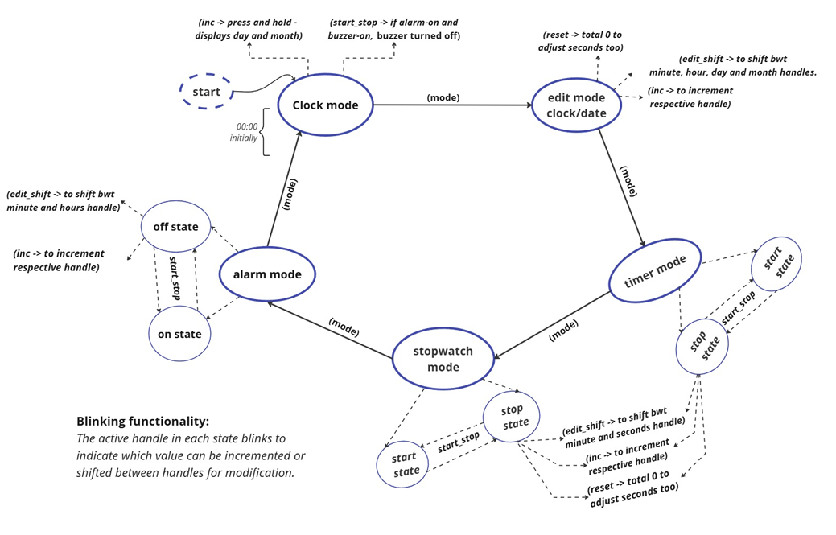
WORK CYCLE:

Slide 8
Challenges Faced During the Design of ChronoFlex-Adaptive-FPGA-Timekeeper
1. Maintaining High Precision at 100MHz Clock Frequency
• Ensuring zero-error functionality with a 10ns clock period, making verification extremely challenging.
• Overcoming software limitations in verifying extended time durations at such high speeds.
2. Concurrent Clock Operation Across Multiple Modes
• Ensuring the clock runs continuously, even when switching between different modes.
• Synchronizing parallel operations without affecting real-time accuracy.
3. Real-Time Synchronization Between Edit and Clock Modes
• Immediate updates to the real-time clock when modifying hours or minutes.
• Ensuring clock updates do not interfere with the Edit Mode.
4. Internal Start/Stop States for Timer, Stopwatch, and Alarm
• Implementing two internal states (Start/Stop) for Timer, Stopwatch, and Alarm while maintaining seamless transitions.
• Ensuring precision in pausing/resuming the stopwatch and timer, as well as stopping the alarm buzzer.
5. Accurate Date & Month Tracking
• Handling varying month lengths, including February with 28 days.
• Ensuring automatic date rollovers at midnight and month transitions.

Slide 9
Challenges Faced During the Design of ChronoFlex-Adaptive-FPGA-Timekeeper
6. Multi-Mode Management Using FSM
• Implementing Clock, Edit, Timer, Stopwatch, and Alarm in a structured finite state machine (FSM).
• Ensuring smooth mode transitions without conflicts.
7. Blinking Seven-Segment Displays for Active Fields
• Handling blinking patterns to indicate active fields like:
- Minutes/Seconds in Timer & Stopwatch
- Hours/Minutes in Edit & Alarm Modes
• Managing multiplexing without visual glitches.
8. Managing Multiple Blocks of Code for Seven-Segment Displays
• Properly mapping values to specific display segments in different modes.
• Ensuring proper display updates without glitches or data corruption.
9. Buzzer Activation for Alarm & Control in Clock Mode
• Managing on/off control of the buzzer only when needed.
• Avoiding unwanted triggers when transitioning between modes.

Slide 10
Challenges Faced During the Design of ChronoFlex-Adaptive-FPGA-Timekeeper
10. Debounce-Free Push Button Handling
• Preventing bouncing effects while ensuring reliable input detection.
• Ensuring a minimum 0.15s activation time while keeping the function active until the button is released.
11. Long Press Functionality in Clock Mode
• Enabling long press actions to view alarm time and date/month.
• Ensuring long press detection does not interfere with normal button presses.
12. Handling Limited Display for Date & Month in Edit Mode
• Managing only two available displays while incorporating date and month modifications.
• Ensuring seamless switching between time and date parameters.

Slide 11
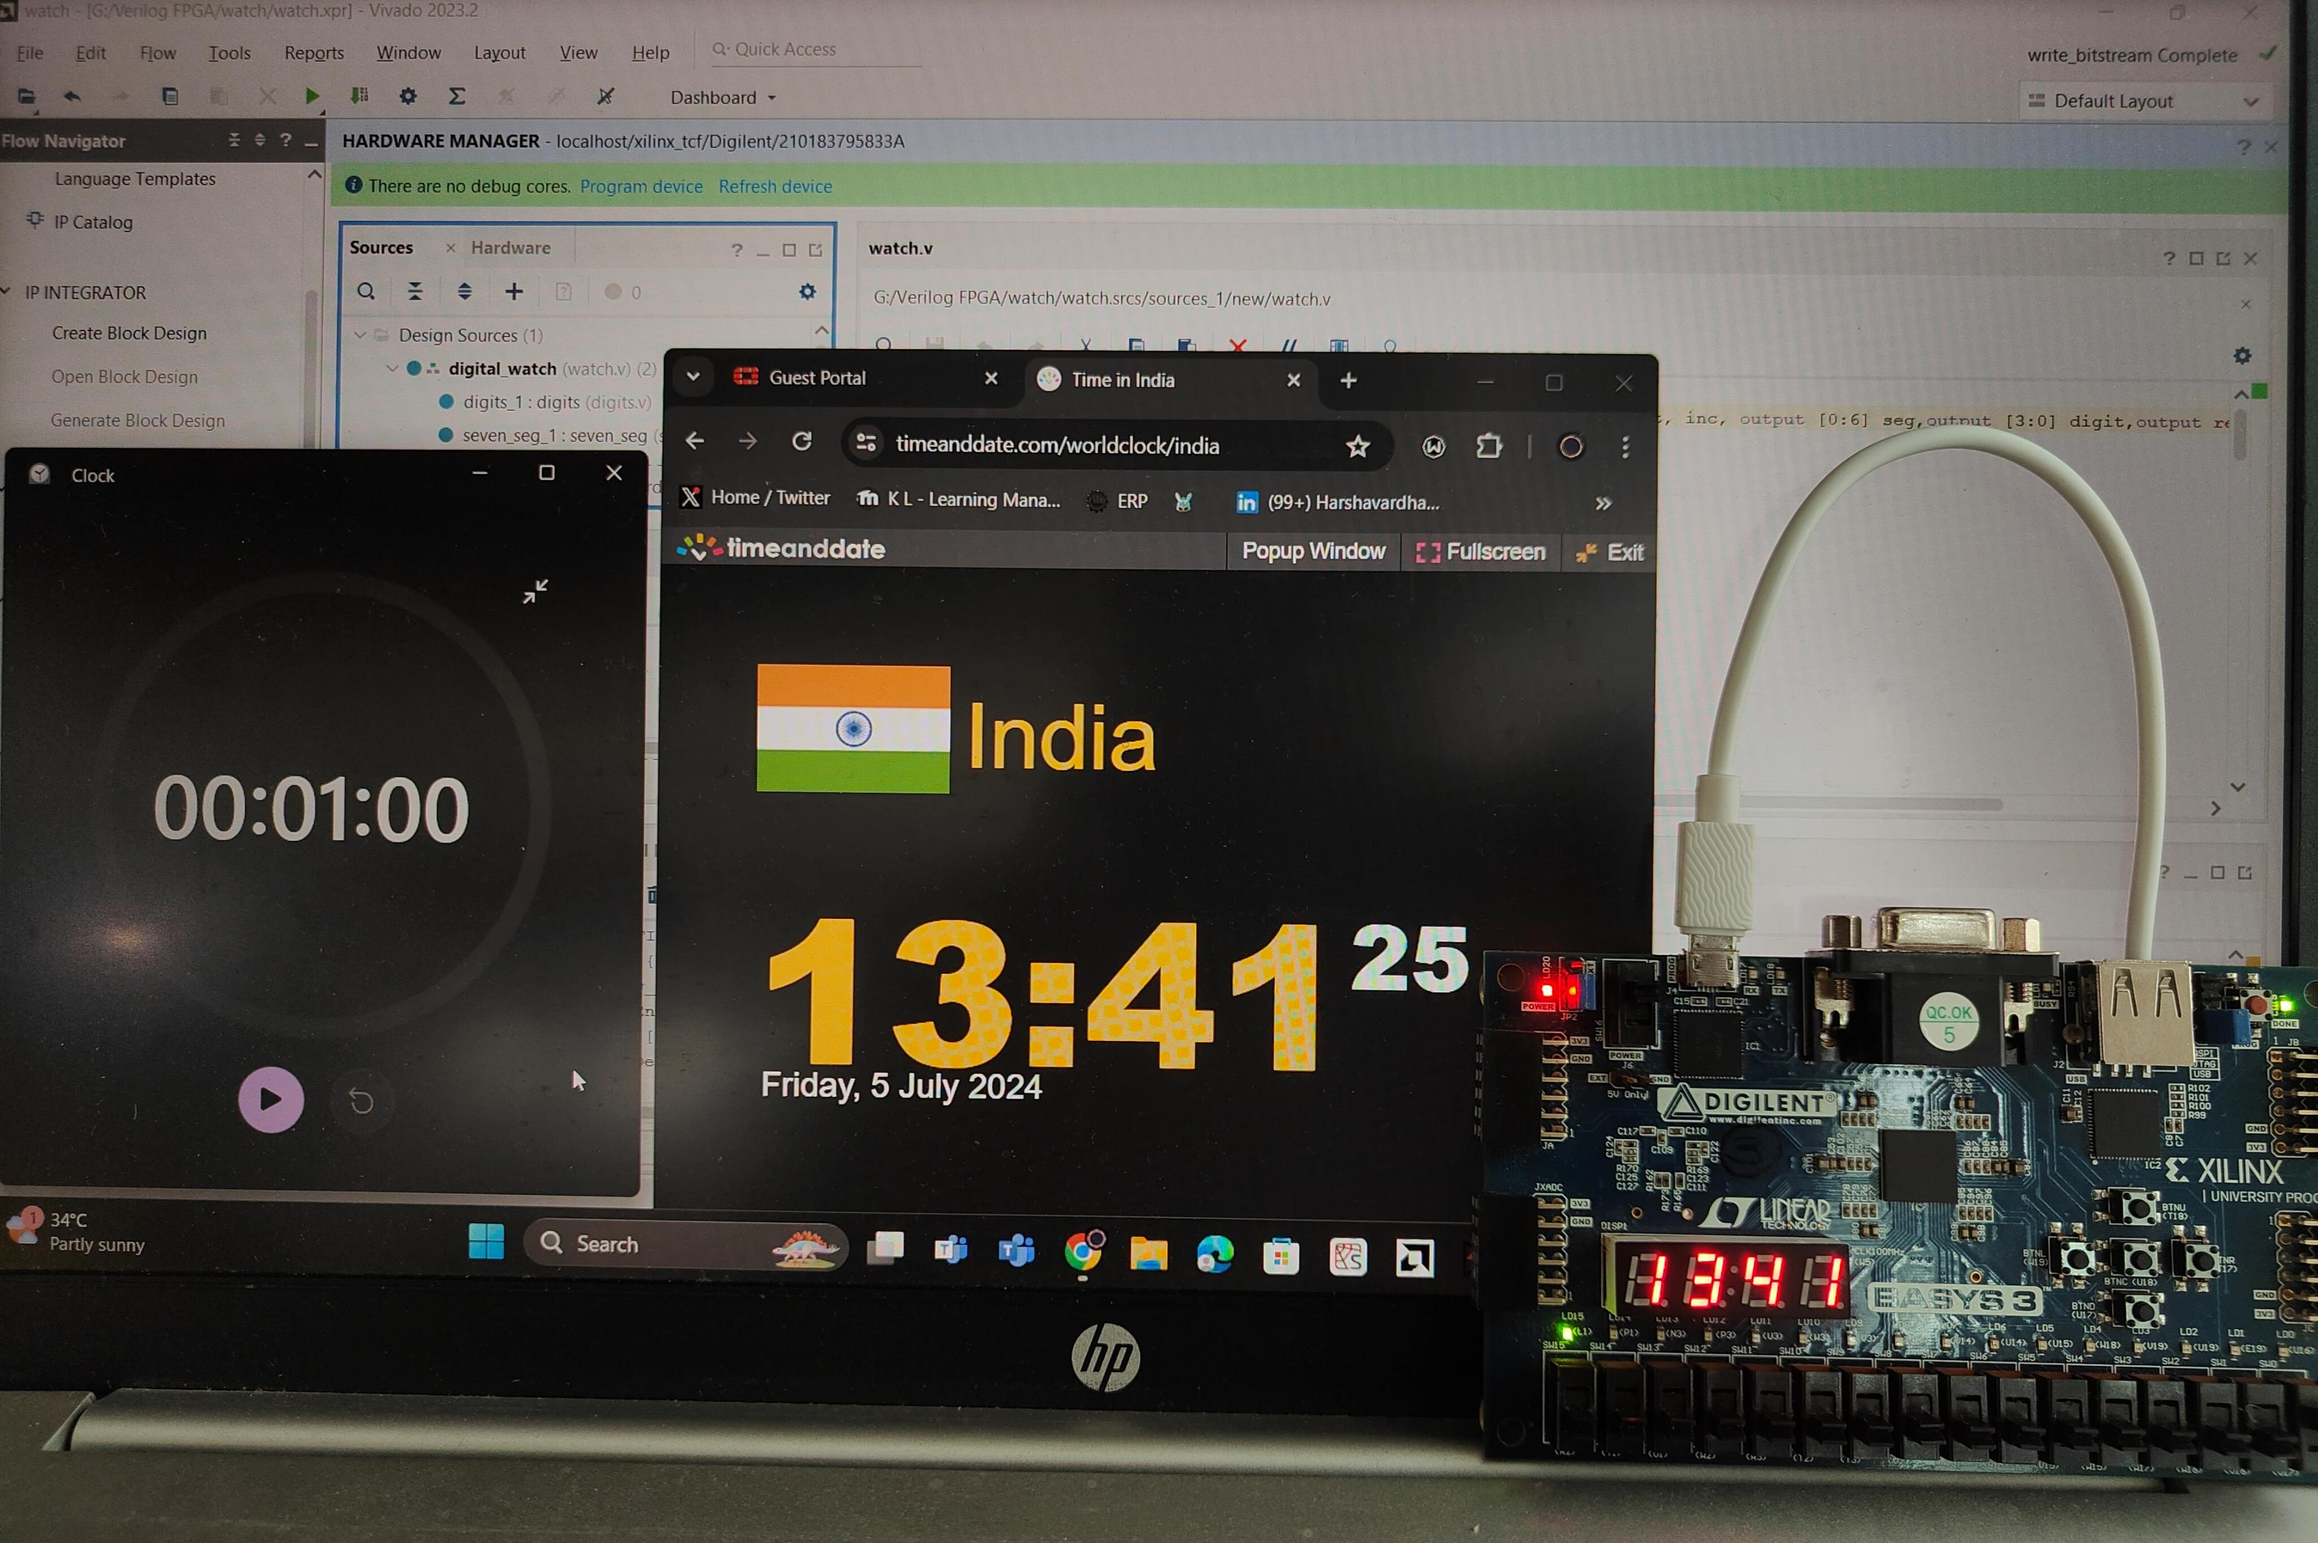
THANK YOU
Github: https://github.com/vardhan3003/ChronoFlex-Adaptive-FPGA-Timekeeper

